Slide 1
A Simple Store Inventory System
Ada Plugues | Carlos Salas

Slide 2
System Description
Our project is a proof of concept example of a store inventory database application.
It allows one to keep track of store inventory, products sold by various stores, suppliers of products, and customers of products.
When displaying larger outputs the user is also given the additional option to save the output to a .csv file.

Slide 3
System Implementation
A Simple Design was chosen with a command line UI reminiscent of older computer programs from the 1980’s.
The application is written in python and allows the user to engage in the aforementioned use cases by accessing, inserting into, or deleting from the database via a number selection menu system.
Project Github: https://github.com/adaPlu/BarcodeDatabase

Slide 4
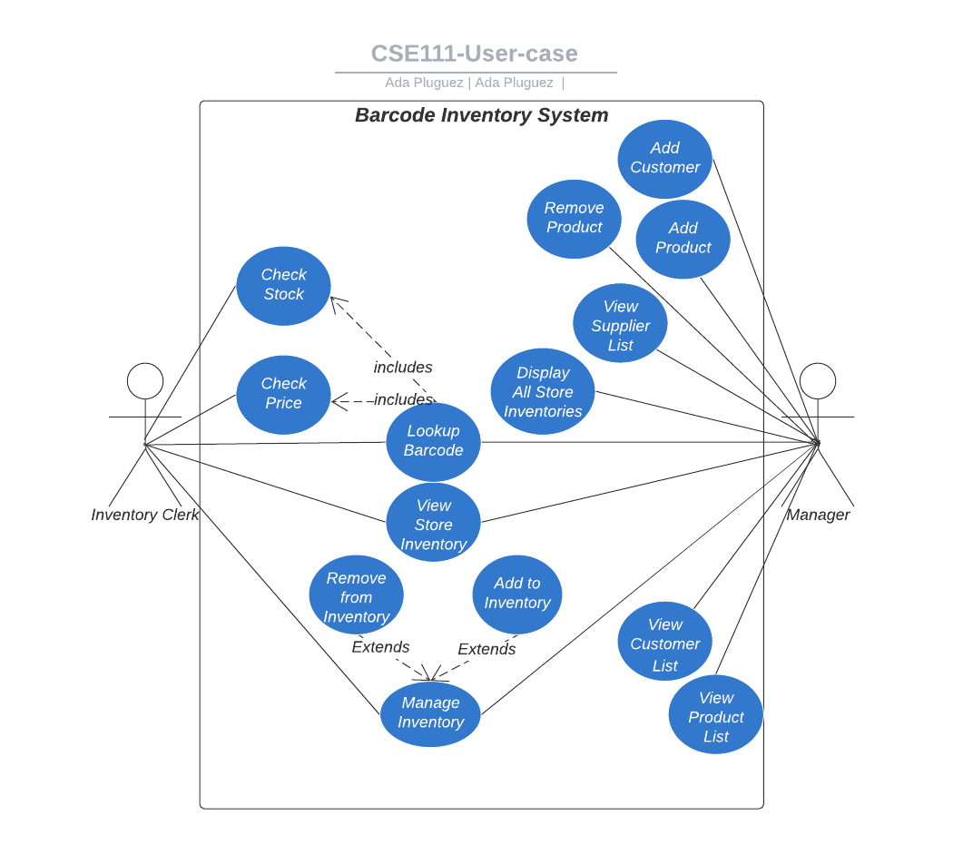
Use-case Diagram

Slide 5
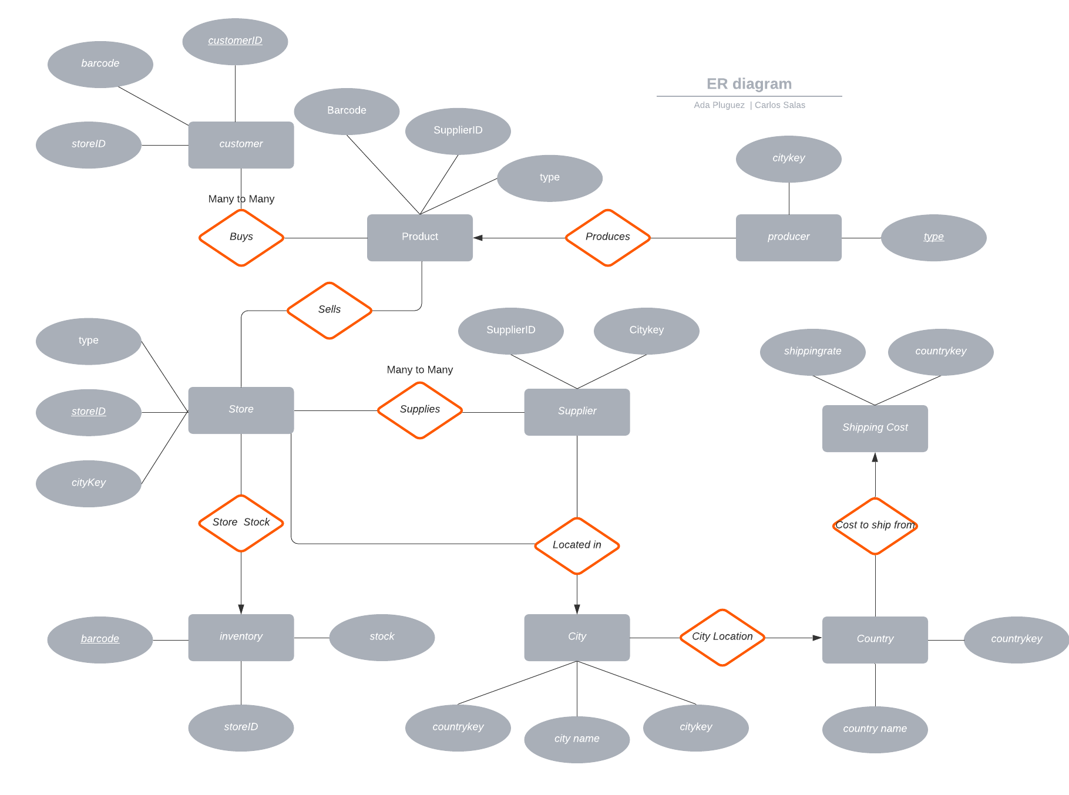
E/R Diagram

Slide 6
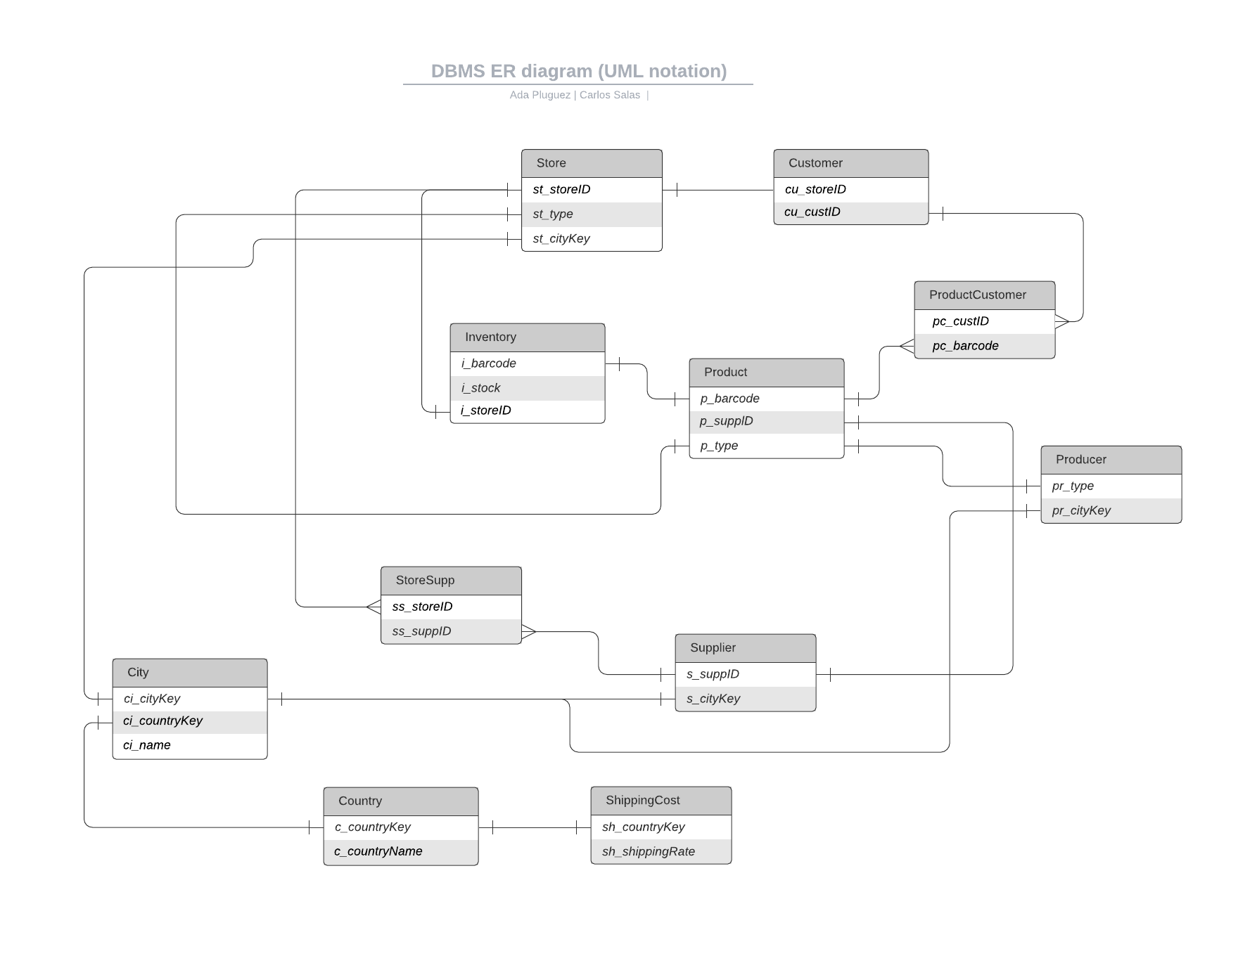
Relational Schema

Slide 7
Thank You

